Slide 1
Back End Engineering
University Management System
Team Details:
1.Somya Sharma:2410990718
2.Anshul Makhija:2410990930 3.Piyush: 24109990654
Chitkara University Institute of Engineering and Technology, Chitkara University,
Punjab

Slide 2
Introduction
University Management System
The University Management System (UMS) is a web-based platform designed to manage academic and administrative activities within a university.It helps automate processes such as student management, faculty management, course management, attendance tracking, and academic records.
The system provides a centralized platform where administrators, faculty members, and students can access and manage information efficiently.By digitizing university operations, the system improves data accuracy, communication, and overall management efficiency.
2

Slide 3
Problem Statement
Managing student, faculty, and course records manually is time-consuming and prone to errors.
Universities often face difficulties in organizing academic data efficiently.
Tracking student attendance, grades, and course enrollment becomes complicated without a centralized system.
Communication between administration, faculty, and students can be inefficient.
Therefore, there is a need for a digital platform that simplifies and automates university management processes.

Slide 4
Project Objective
The main objective of the University Management System is to digitize and automate university operations.
The system allows administrators to manage students, faculty, courses, and academic records efficiently.
Faculty members can manage courses, student attendance, and grades.
Students can access their profiles, course information, and academic performance easily.

Slide 5
Key Features
•
Student management system for storing and managing student records.
•
Faculty management system to manage faculty information and course assignments.
•
Course management to organize subjects and academic programs.
•
Attendance tracking system for monitoring student attendance.
•
User-friendly interface for administrators, faculty, and students.

Slide 6
Benefits/Advantage
Simplifies university administration and academic management.
Reduces manual paperwork and administrative workload.
Improves data accuracy and organization.
Provides quick access to student and faculty information.
Enhances communication between administration, faculty, and students.

Slide 7
Technology Used
The project is developed using modern web technologies.
HTML is used to structure the website pages.
CSS is used to design and style the user interface.
JavaScript is used to add interactivity and dynamic features.
Node.js and Express.js are used for backend development

Slide 8



System Architecture
▪
The system follows a simple three-layer architecture.
Presentation Layer
User interface built using HTML, CSS, and JavaScript.
Application Layer
Handles business logic such as managing students, courses, and attendance using Node.js and Express.js.
Data Layer
Stores university data such as student records, course details, and attendance information in the database.

Slide 9
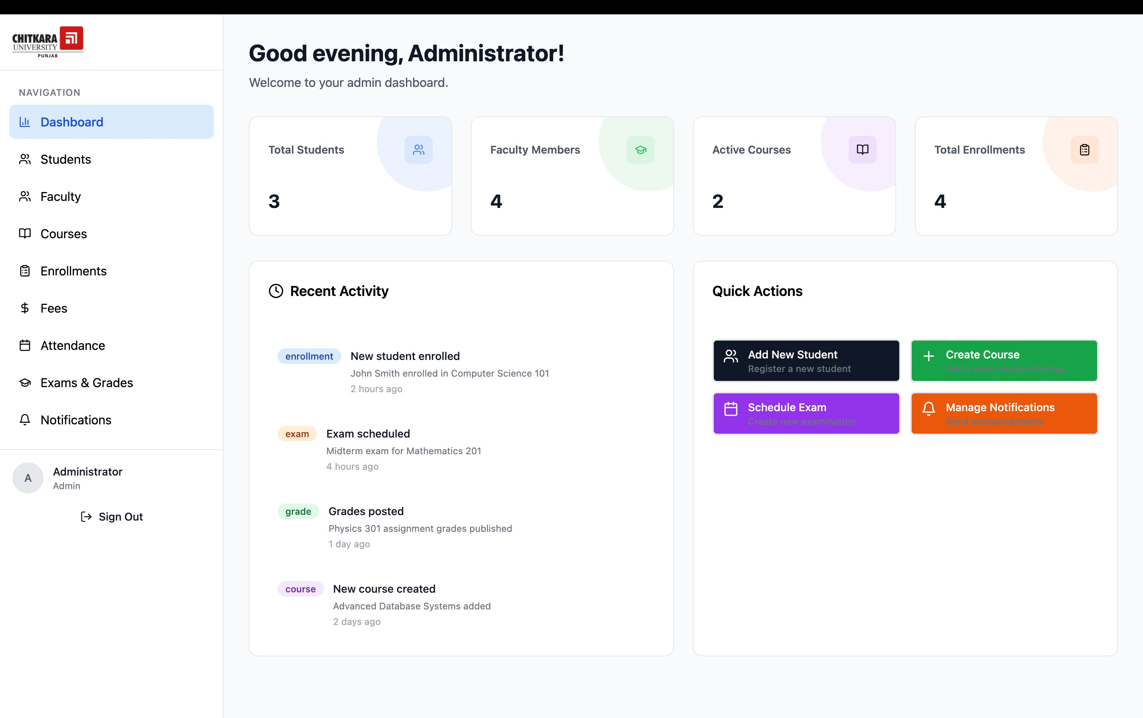
Home page

Slide 10
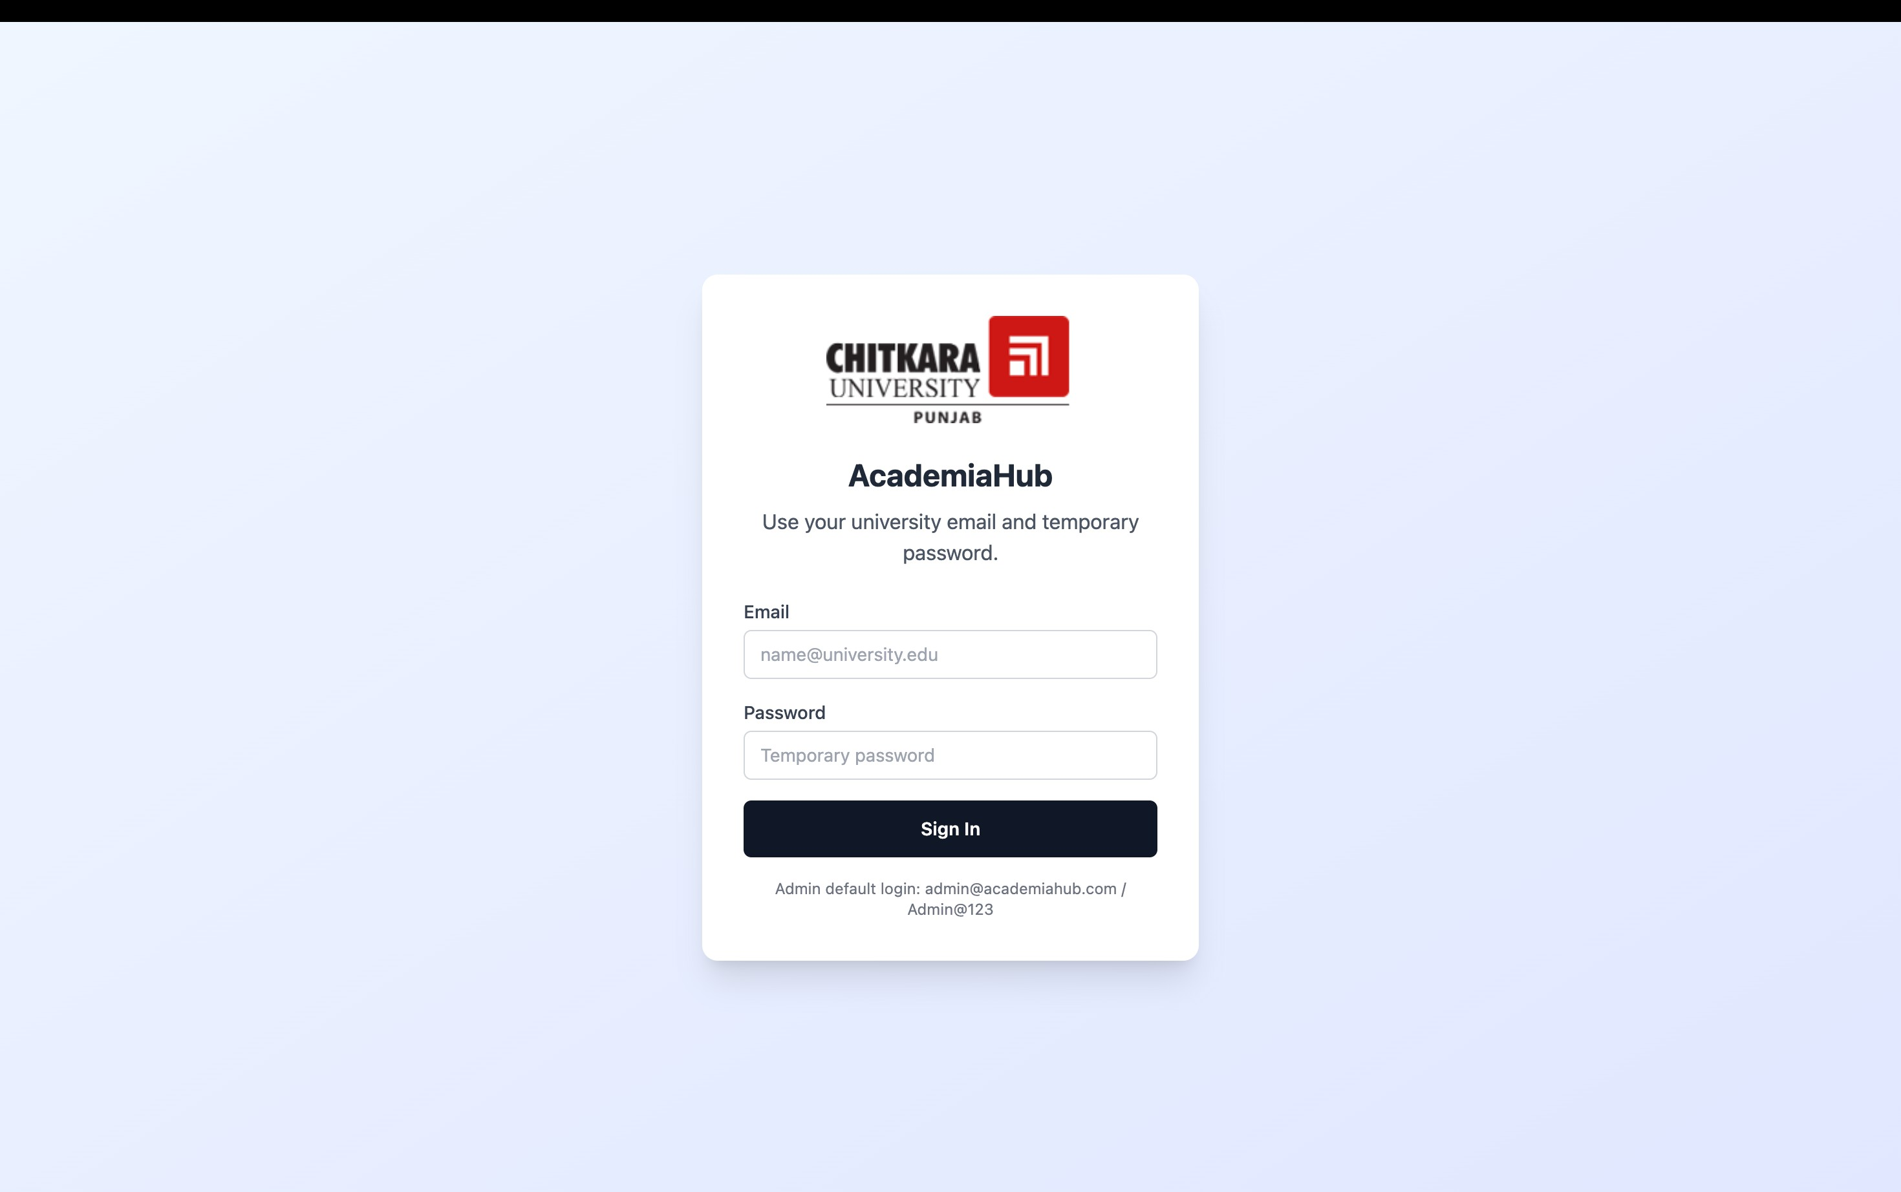
Sign Up Page

Slide 11
Future Improvemenst
Mobile application for students and faculty.
Online fee payment integration.
Real-time notification system.
Advanced analytics and reporting.
Integration with learning management systems.

Slide 12
Conclusion
The University Management System provides an efficient solution for managing university operations digitally.It simplifies the management of students, faculty, courses, and academic records.
The system reduces manual workload and improves data organization and accessibility.Overall, it enhances the efficiency and transparency of university administration.

